Slide 1
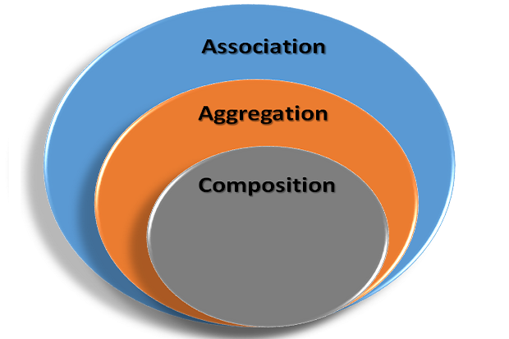
Association vs Aggregation vs Composition c++
Asma Naseer

Slide 2
Association vs Aggregation vs Composition
Aggregation and Composition are subsets / specific cases of association
In both, object of one class "owns" object of another class.
There is a subtle difference:
Aggregation implies a relationship where the child can exist independently of the parent. Example: Class (parent) and Student (child). Delete the Class and the Students still exist.
Composition implies a relationship where the child cannot exist independent of the parent. Example: House (parent) and Room (child). Rooms don't exist separate to a House.

Slide 3
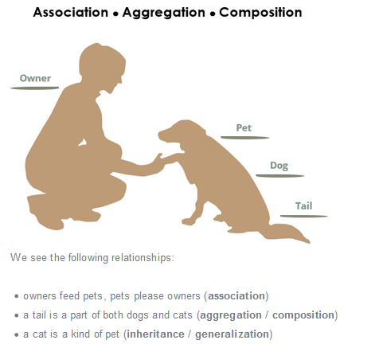

Slide 4
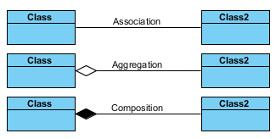
Unified Modeling Language (UML)

Slide 5

UML- Generalization

Slide 6
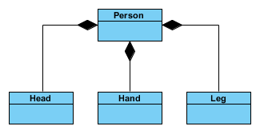
Composition

Slide 7
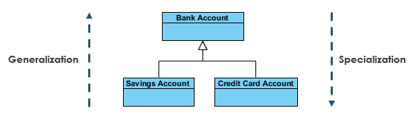
Generalization vs Specialization

Slide 8
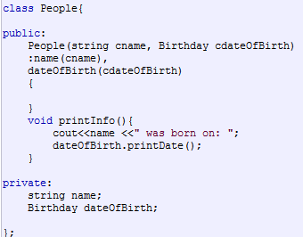


Composition

Slide 9
Composition … Exercise
class Name
Data Members: firstName, secondName, lastName
Member Function / Constructors, setters, getters, display
Class Student
Data Members: studentName, Dept, CGPA
Member Function / Constructors, setters, getters, display
Main
Create and Instance of Student
Display the values

